Slide 1

Impact of Coronavirus on Education and Revival

Slide 2
INTRODUCTION
Education one of the biggest victim of coronavirus.
Transition in teaching learning process.
In this report we’ll review the impact of Coronavirus on education and draw out important points to consider while reviving the education system back on track

Slide 3
Statement of the Problem
To study the consequences of Coronavirus pandemic on Education.
After almost one year of Coronavirus pandemic,
Which is better Online or Offline classes?
What protocols and key points we need to keep in mind before restarting offline classes.

Slide 4
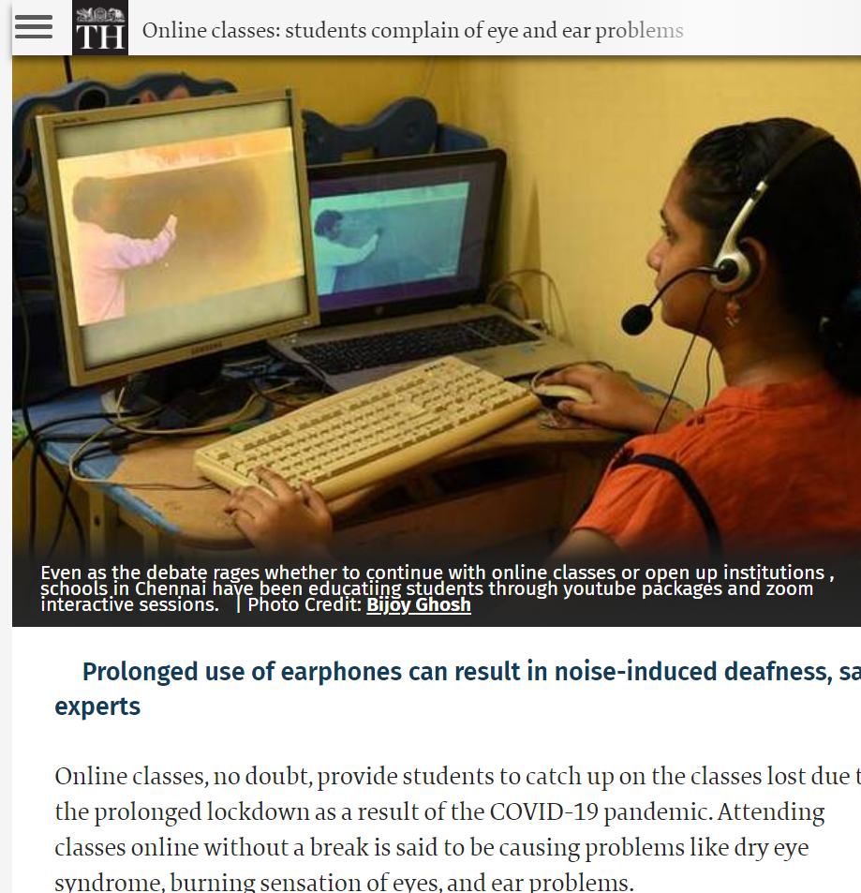

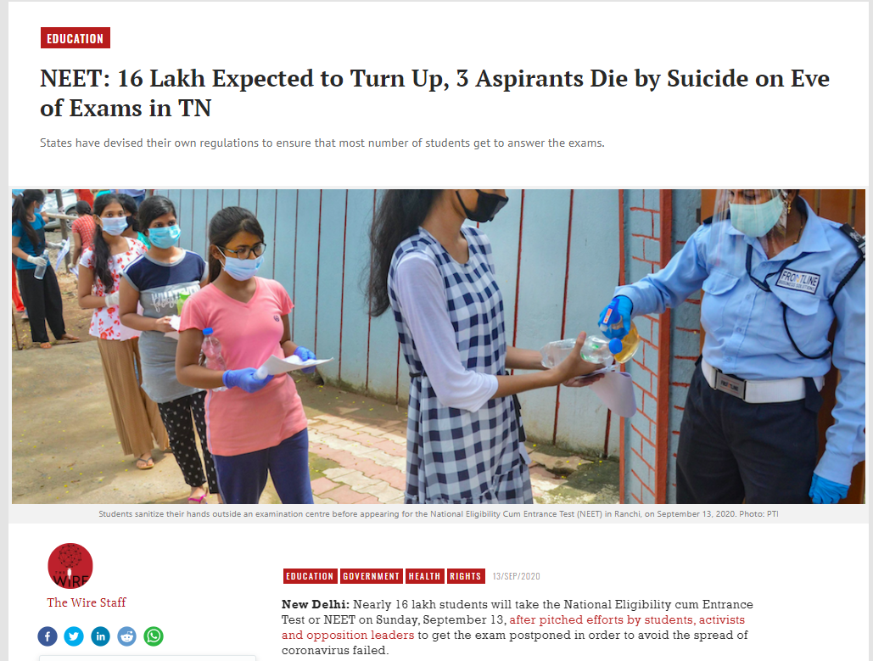
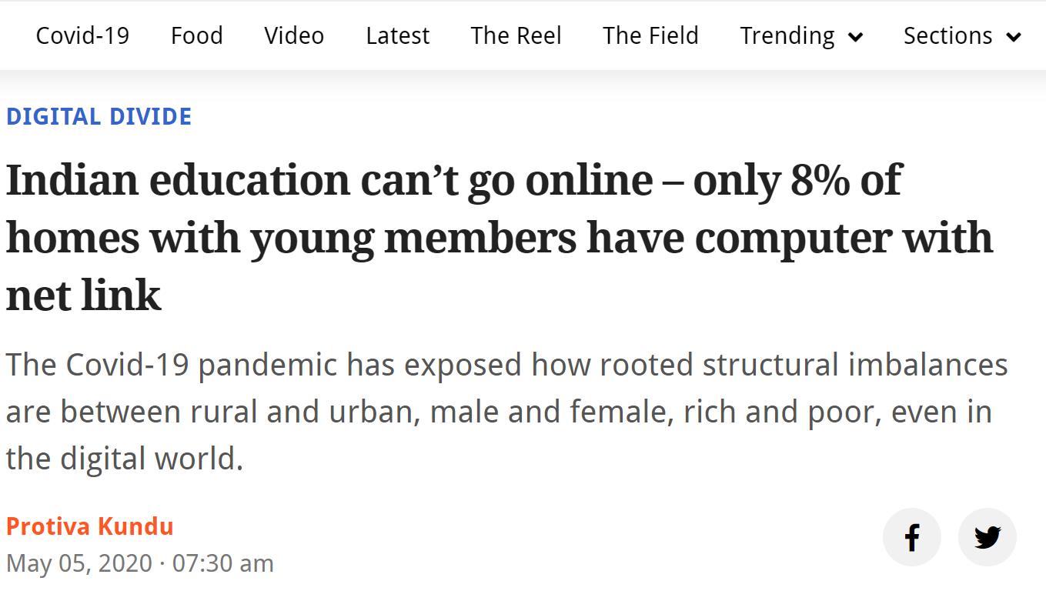
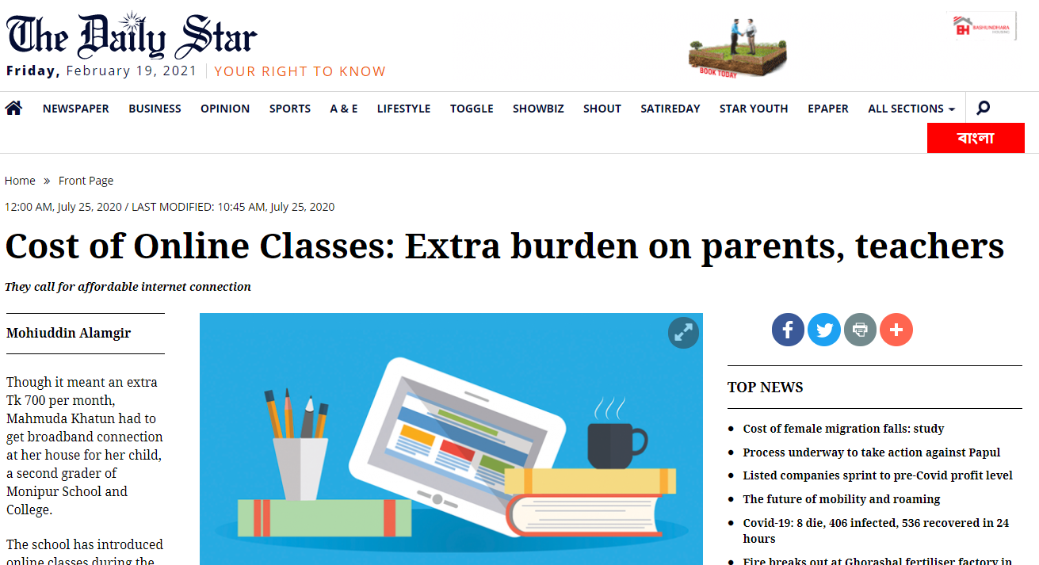
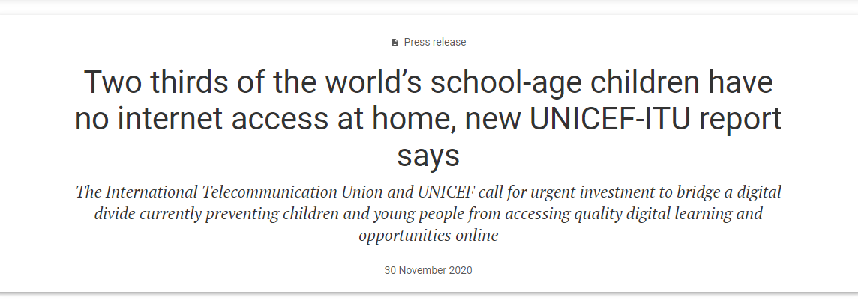
Significance of the Problem
Impact of Coronavirus on students education
School Closure.
Problem of Distance Learning.
Access of Internet and other services in remote areas.
Extra burden on Parents and Teachers.
Increased anxiety within students due to uncertain Exams.
Gap in Academic Progress.
Loss of hopes for pursuance of International Education.
Impact on physical health of students.
Lack of mutual interaction between students due to online classes.

